Slide 1
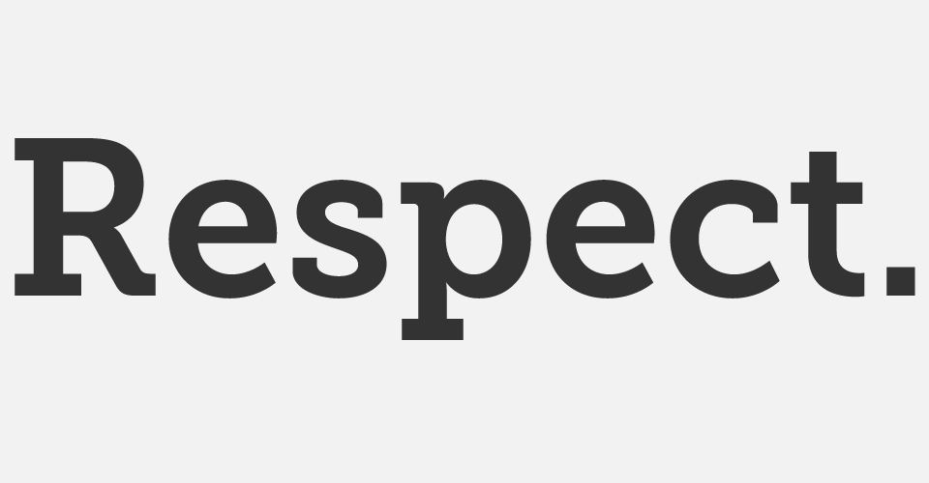

Slide 2
What does “respect” actually mean?
“due regard for the feelings, wishes, or rights of others.”

Slide 3
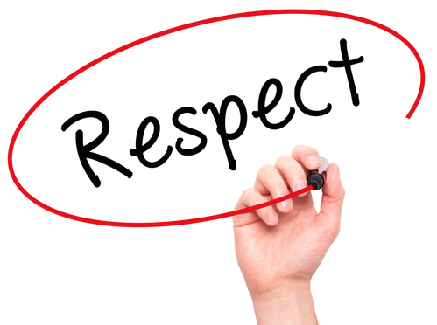
“due regard for the feelings, wishes, or rights of others.”
“due regard for the feelings, wishes, or rights of others.”

Slide 4
“due regard for the feelings, wishes, or rights of others.”
Due means deserved.
So, surely, in order to receive respect you have to earn it.

Slide 5

According to the dictionary, the verb ‘to respect’ means:
verb
1.
admire (someone or something) deeply, as a result of their abilities, qualities, or achievements.

Slide 6
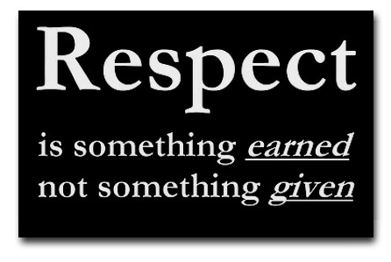
So who might deserve our respect?

Slide 7
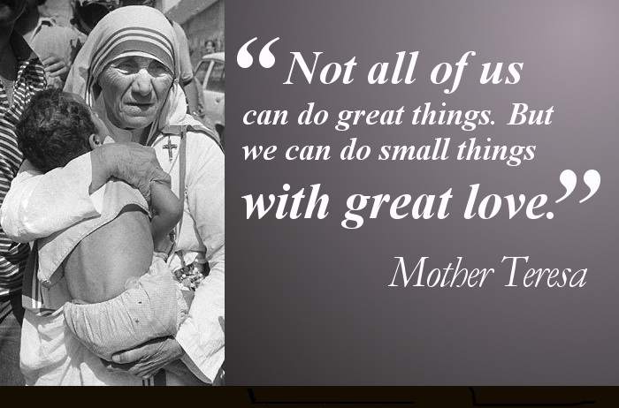

Slide 8
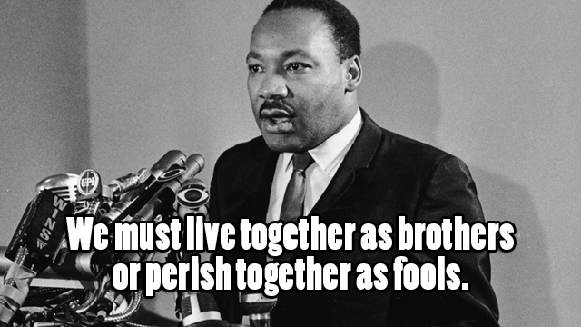

Slide 9
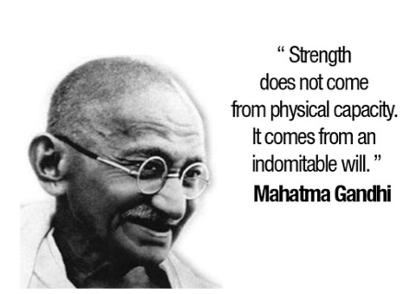

Slide 10
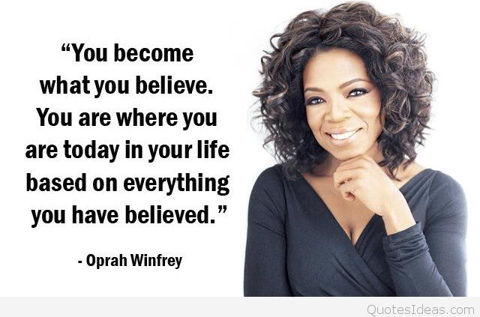

Slide 11
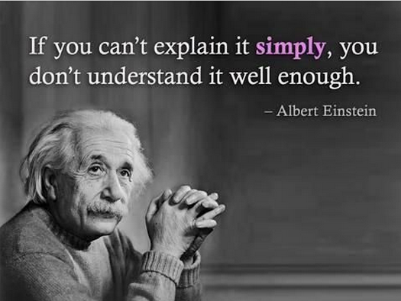

Slide 12
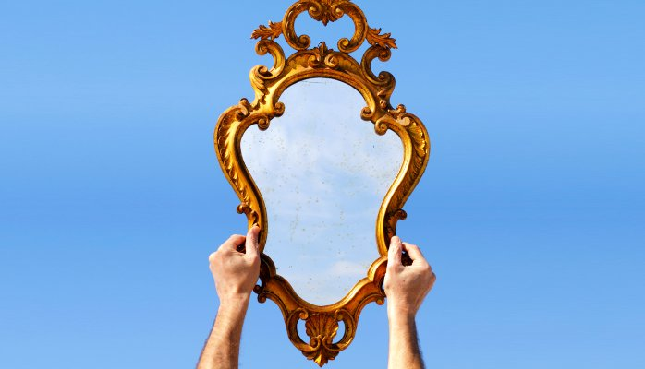


Slide 13

Hmmmmmmmm.
What do you do that deserves respect?

Slide 14
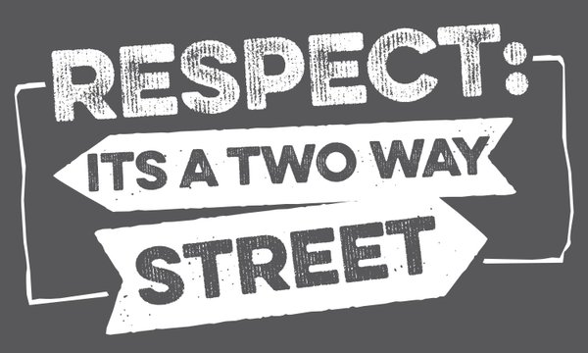

Slide 15
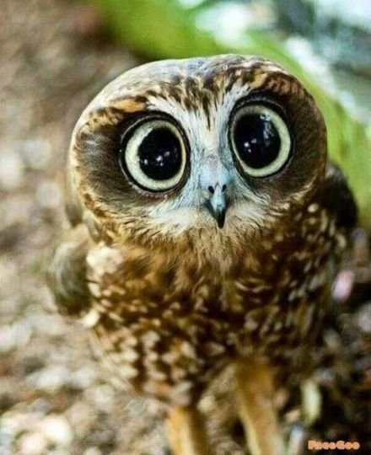
Watch the following clip…
https://www.youtube.com/watch?v=nJJa9f0I8XQ
FULL ATTENTION PLEASE!

Slide 16
How was RESPECT presented?
What did the man do in the video that showed his respect for others?
What did you think of his actions?
Why?
Was he rewarded at all for doing what he did every day?

Slide 17
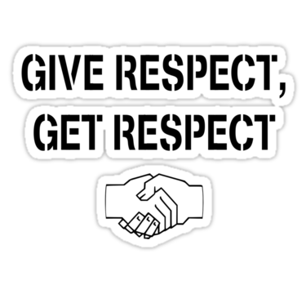

Slide 18
Before you leave this assembly…
Decide on one thing that you will do (no matter how small or large it may be) to show respect for someone or something other than yourself today.
Maybe start everyday this way. Don’t expect reward or praise. Just know that respect comes to those who show it.
Because Mother Theresa, Martin Luther King, Gandhi, Oprah Winfrey and Einstein probably sat in a RESPECT assembly very similar to this and look what they became!

