Slide 1
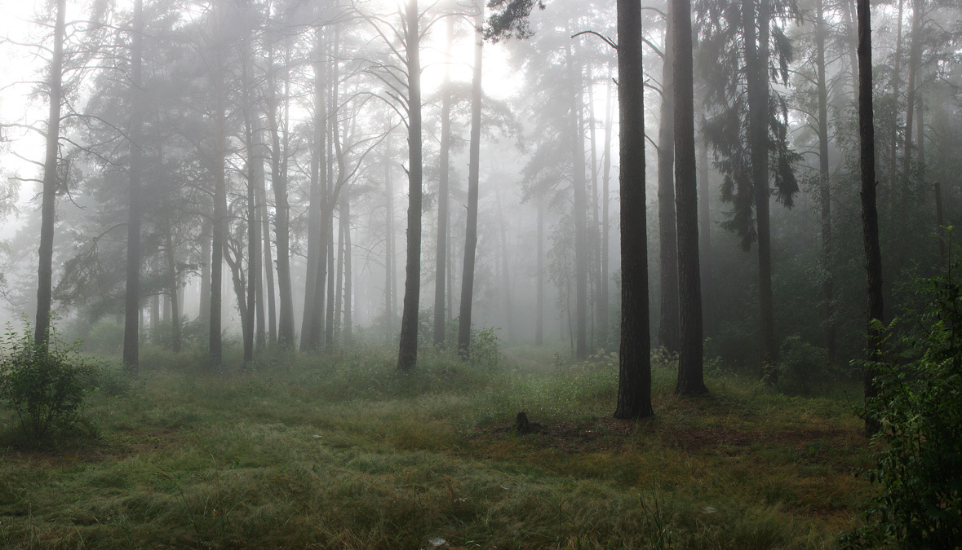
Real Life Mysteries
Write your own

Slide 2
What is a mystery?
Ever had something happen to you that seemed impossible or unlikely?
Ever experienced déjà vu?
Ever witnessed something that unsettled you?
Made you wonder HOW that happened?
Or WHERE that person disappeared to?
You may have experienced a mystery!

Slide 3
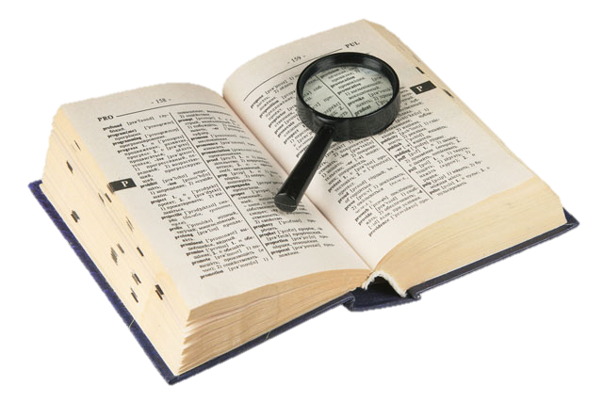
What is a mystery?
something that is difficult or impossible to understand or explain.
a novel, play, or film dealing with a puzzling crime, especially a murder.

Slide 4
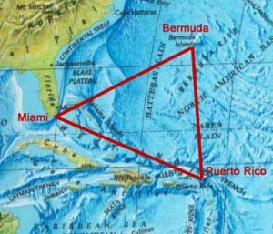
The Mystery of The Bermuda Triangle
Known as the Bermuda Triangle, this legendary expanse of ocean can be found between the points of Miami, Bermuda, and Puerto Rico. Pilots often tell of their planes going haywire over the triangle and numerous ships have been lost at sea there. With explanations ranging from gas bubbles to aliens, no one is sure what is behind the strange phenomena.

Slide 5
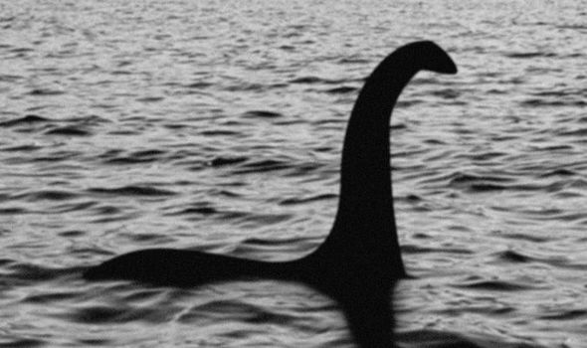
The Mystery of The Loch Ness Monster
For ages, people have been hearing about the Loch Ness monster and how it baffled everyone thinking that it is a creature unlike any other. There have been many sightings over the years and photos and videos of actual footage have been checked and looked at time and time again, confirming if it could be some kind of sea serpent or a descendant of the dinosaurs. Even today, as some are claiming, it still exists and swims under the waters of the Loch.

Slide 6
What real life mysteries have you experienced/witnessed?
Have you ever met someone you’ve had a feeling you’ve met before?
Ever bumped into your doppelganger? (Lookalike)
Ever had an out-of-body experience?
Have you ever witnessed something or someone disappear?
Have you ever experienced/
witnessed something that couldn’t be explained?
Have you ever met experienced something you felt you’d already been through?

Slide 7
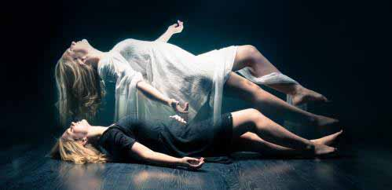
What is an out-of-body experience?
An out-of-body experience (sometimes called an OBE) is an experience that typically involves a feeling of floating outside one's body and, in some cases, the feeling of viewing one's own physical body as if from a place outside one's body.
Understandably, it can be slightly unsettling.

Slide 8
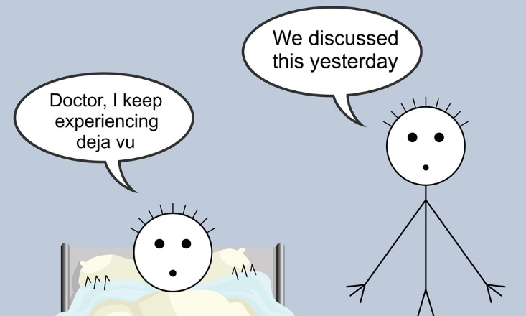
What is déjà vu?
Déjà vu, from French, literally "already seen", is the phenomenon of having the strong sensation that an event or experience currently being experienced has already been experienced in the past.
You may feel you have met someone before that you haven’t or been somewhere already. It can be quite a shock to the system to find you haven’t!

Slide 9
Engaging ‘Mystery’ Vocabulary
Menacing
Intimidating
Bloodcurdling
Forbidding
Daunting
Terrifying
Chilling
Creepy
Frightening
Dark
Dim
Shady
Unattractive
Hideous
Unsightly
Revolting
Repulsive
Obnoxious
Threatening
Dangerous
Intimidating
Menacing
Hostile
Aggressive
Scared
Frightened
Shadowy
Murky
Gloomy
Sinister
Mysterious
Threatening
Ominous
Evil
Gloomy
Depressing
Bleak
Gruesome
Grisly
Ghastly
Shrill
Vociferous
Rowdy
Boisterous
Raucous
Riotous
Blaring
Devious
Sly
Deceitful
Crafty
Cunning
Scheming
Afraid
Terrified
Fearful
Petrified
Nervous
Worried
Anxious
Timid
Timorous
Relieved
Reassured
Thankful
Calmed
Any words you don’t recognise?

Slide 10
Planning your own Real-Life Mystery
Consider a mysterious experience that you have had.
Create a spider diagram planning what you could write about.
How will you make it engaging for your reader?
What vocabulary will you use to make it interesting?
What linguistic devices such as imagery, simile, etc could you include?
What structural devices such as sentence lengths for impact, repetition etc., could you include?
My Real Life Mystery

Slide 11
What makes this writing mysterious?
I wandered the streets aimlessly, my heart thumping against my ribs. I had no idea as to where I was. And then I saw it. The large, leather strap, wood door with the padlock, the cobwebbed windows. Now, this I recognised. I tiptoed cautiously towards it. I remembered every step. But where from? When had I been here?
A sense of murky dread filled my stomach and I paused to take a breath. I could see myself opening the door, the long out-stretched arm of a hallway that lay behind. The room it led to. My heart was pounding in my ears now. I could remember what was in that room…I turned and ran!
I wandered the streets aimlessly, my heart thumping against my ribs. I had no idea as to where I was. And then I saw it. The large, leather strap, wood door with the padlock, the cobwebbed windows. Now, this I recognised. I tiptoed cautiously towards it. I remembered every step. But where from? When had I been here?
A sense of murky dread filled my stomach and I paused to take a breath. I could see myself opening the door, the long out-stretched arm of a hallway that lay behind. The room it led to. My heart was pounding in my ears now. I could remember what was in that room…I turned and ran!
How could we improve it?

Slide 12

Writing your own Real Life Mystery
(Tick off when completed)
Include varied Mystery-appropriate vocabulary for deliberate effect
Include effective linguistic devices
Include effective structural devices
Include varied sentence lengths for impact
Include varied punctuation to show emotion and feeling.
Mystery

Slide 13

How did you do? Proof check with your partner.
Included varied Mystery-appropriate vocabulary for deliberate effect
Included effective linguistic devices
Included effective structural devices
Included varied sentence lengths for impact
Included varied punctuation to show emotion and feeling.
Sign off with your name:_________________________
2 stars & a wish

