Slide 1


Slide 2

Behaviour Matters

Slide 3
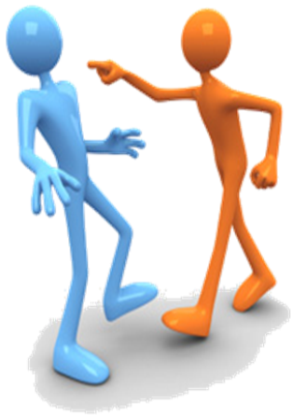

Not just because we ‘say so’ as teachers…
According to the dictionary…
Behaviour is “the way in which one acts or conducts oneself, especially towards others.”

Slide 4

As people, our behaviour not only impacts upon our lives but also, more seriously perhaps, if affects the lives of those around us.
If you are known for your bad behaviour…why would people want to be associated with you?
If you are known for your good behaviour…why wouldn’t people want to be associated with you?

Slide 5
So, how do YOU behave?
Think!
Is your behaviour something that creates a good reputation?
Is your behaviour a concern that is damaging others’ views of you?
Is it something you’re proud of?
Is it something you should change?

Slide 6
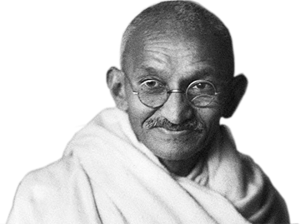
Mahatma Gandhi said…
“Behaviour is the mirror in which we can display our image.”
So why would you want that image to be bad?

Slide 7
Watch the following clip on behaviour in class…
https://www.youtube.com/watch?v=ddvTFgzkS5M
Consider: do you automatically do all these things?
Because these are the basics.

Slide 8
The excuses we give…
On your exam results, no one else’s names will be printed. Only yours.
No one is going to remember all the positive behaviour because it’s overshadowed by the bad.
There’ll be no extra marks for you because Student X was also talking.
You alone face the consequence.
THINK!
“everyone else is talking…”
“it wasn’t JUST me…”
“I’m just distracted.”

Slide 9

It’s not about scaring you…
You are intelligent individuals who realise bad behaviour has a negative impact on you and others.
You don’t want your future reputation to be tainted by moments of silliness or immaturity.
You don’t want one or two bad mistakes to follow you into your future.
You are better than bad behaviour.
It’s in your hands.

