Slide 1
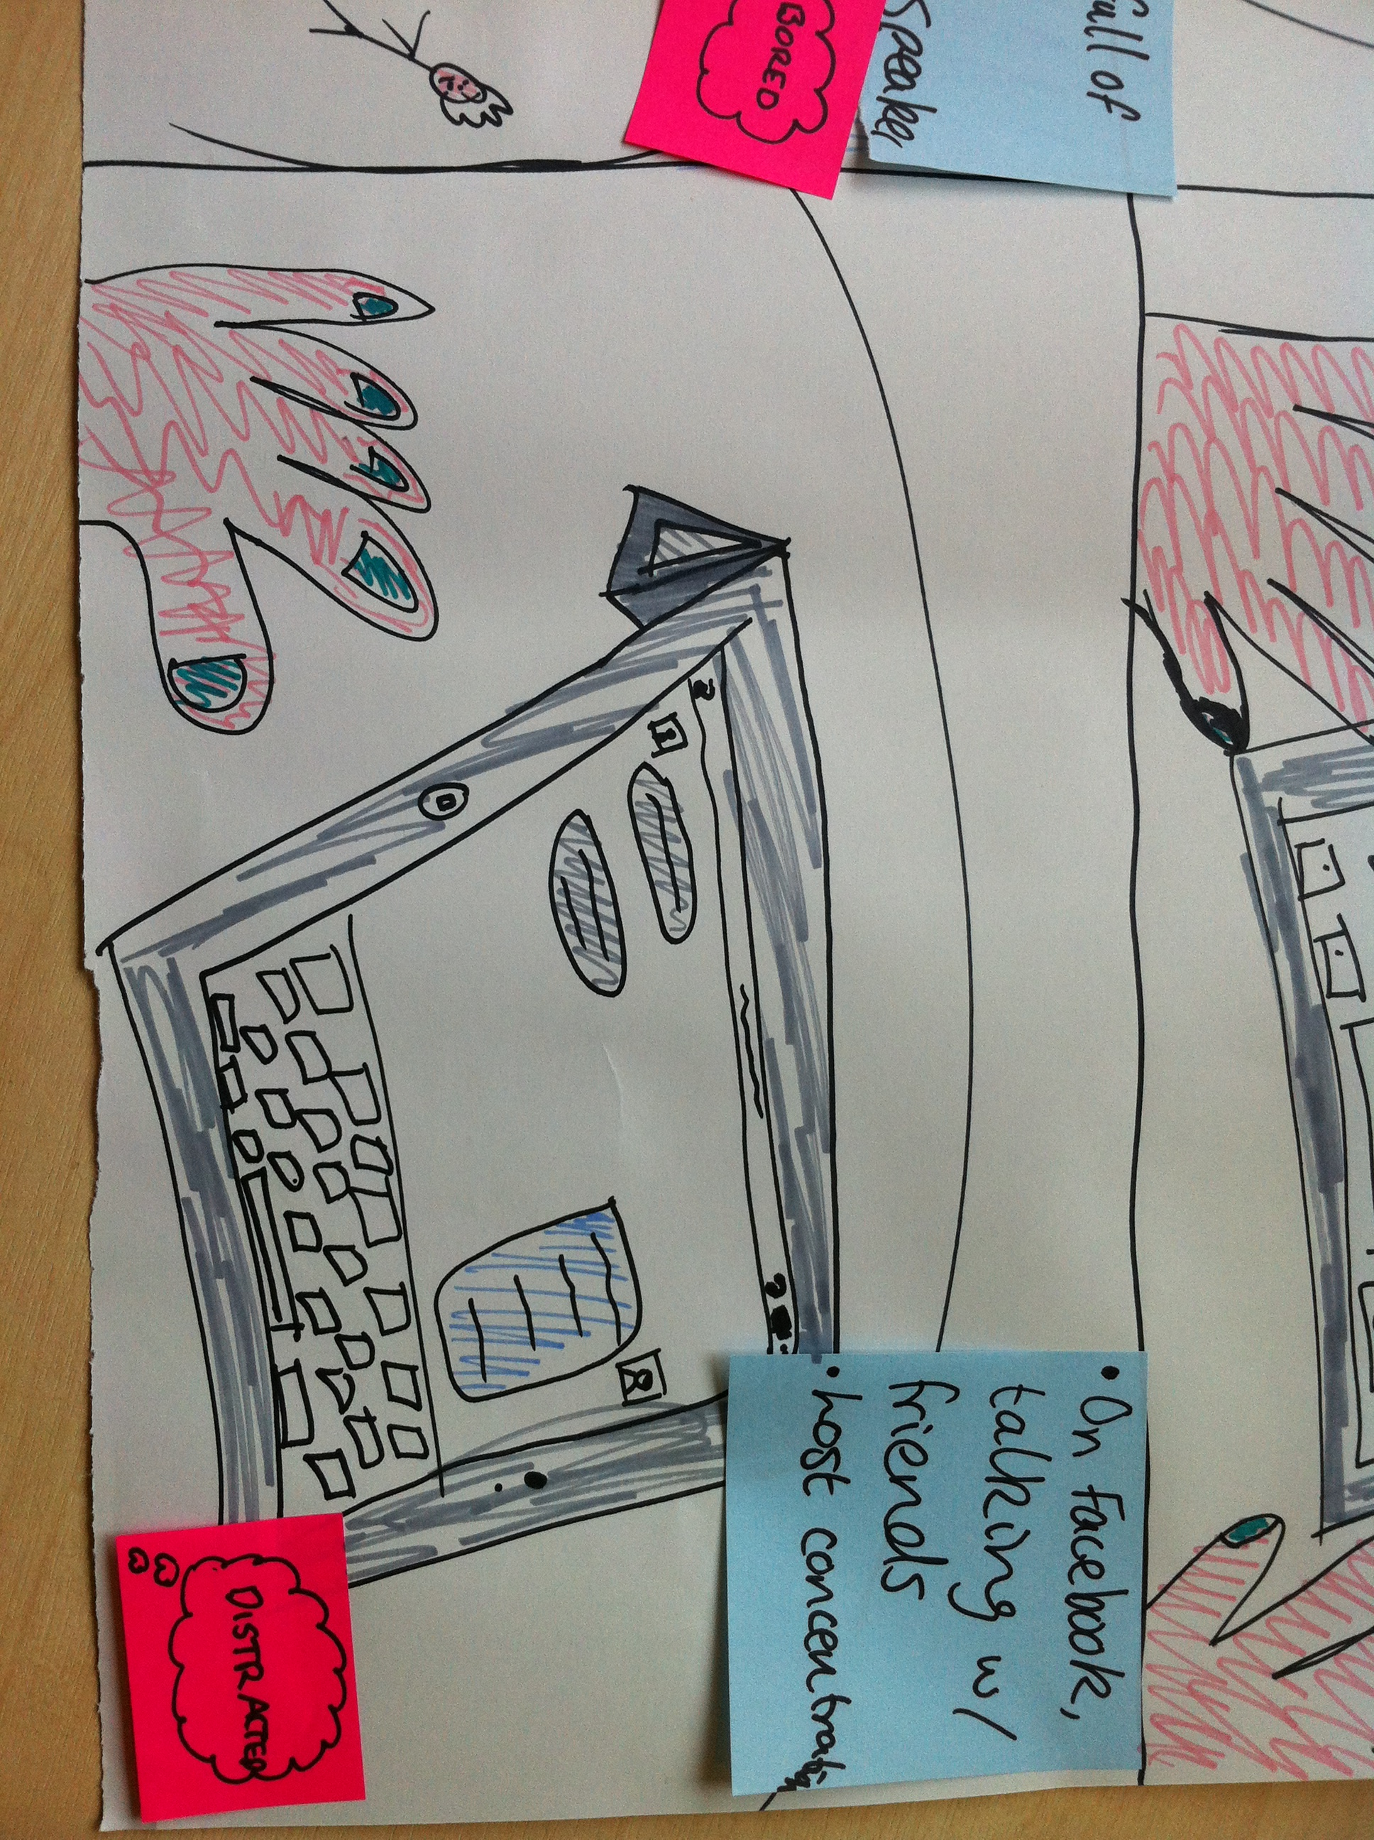
“so I go on Facebook and start talking to my friends, who are also in the lecture, because we’re quite bored, and lost, and don’t know what to do”
Elaine Brown, Director of Studies (FST) & University Teaching Fellow @ElaineBrownARU
With thanks to Anglia Learning & Teaching, Dr Debbie Holley & Dr Mike Hobbs

Slide 2
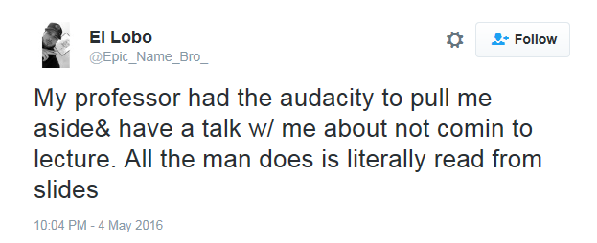
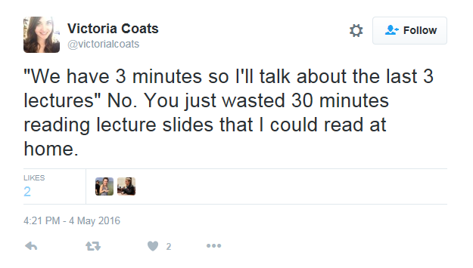
Lauren (@noctilums) “I looked up and twenty slides have gone by I don’t know what’s going on in this lecture” May 3, 2016 6:11PM [tweet]
“by living a digital lifestyle
they have become the center
of their digital egosystem”
(Solis, 2015)

Slide 3
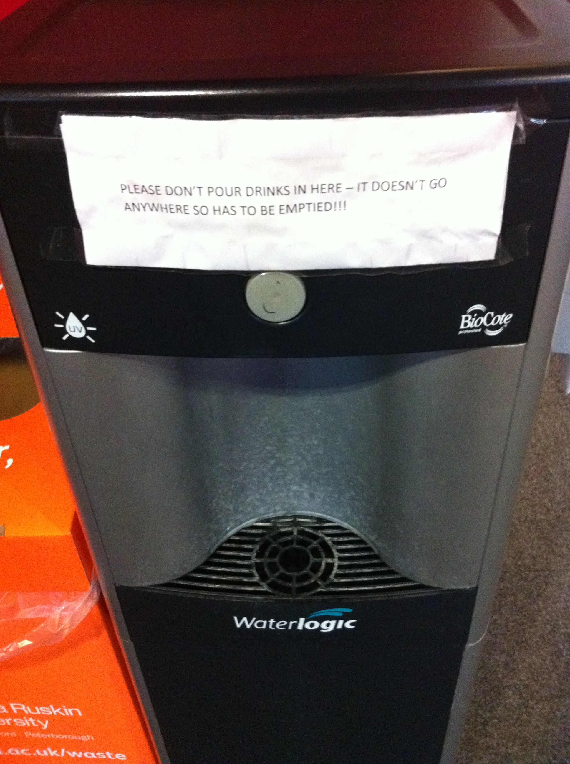
Lee, Britney (@BLJLEE) “now that all my exams are done, I just realized that not one of the slides I took pics of in class were used while studying” May 6, 2016 12:55AM [tweet]

Slide 4
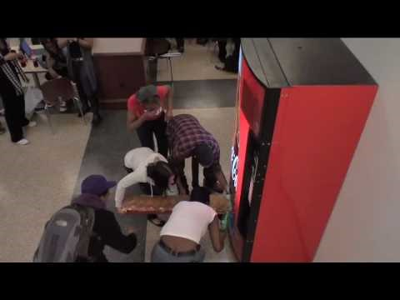
Wahlgran, Kendall (@kwahlgreen16) “Greatest feeling, lecture hall teacher learned my name because she enjoyed my paper so much” May 5, 2016 12:49AM [tweet]

Slide 5
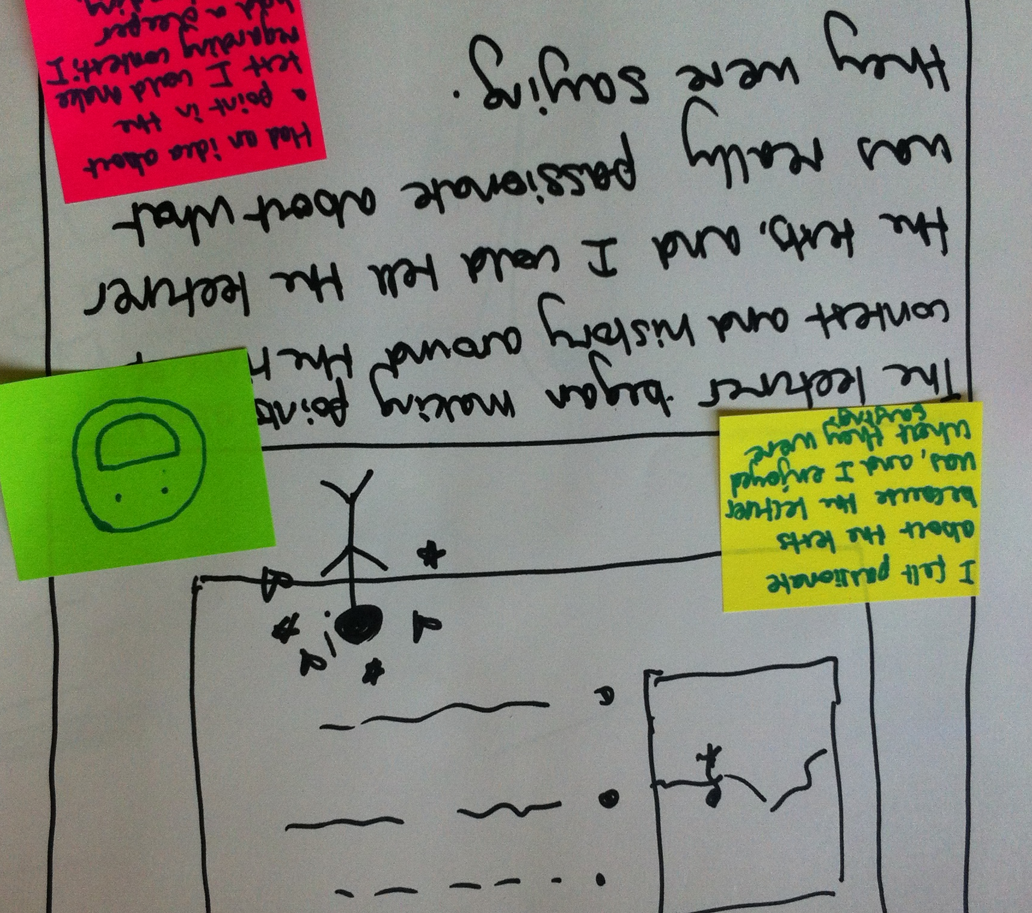
Why do you go to lectures?
“Enthusiastic lecturers that
inspire us” “love what they
are doing”
“Not preparing for lectures
makes you not want to go
to a lecture”
“to prepare for exams”
“I’ve paid for it”
“Guilt”

Slide 6
Are there any circumstances under which you would not miss a lecture?
“Yes [laughs], it was two days after surgery and I still came in. I was sat in the front row, and the lecturer said “You should not be here”, but I was
“I’m doing this essay, I’m taking notes”. Even though I could have got the notes from someone else, you can’t get that immersive experience. I still don’t find it from recordings either”

Slide 7
“Finally
I actually enjoy
going to them”

